Slide 1

END SEMISTER PROJECT
DESIGN AND ANALYSIS OF ALGORITHMS
CONNECTED COMPONENTS AND RELATED ALGORITHMS USING LINEAR ALGEBRA
TEAM - 11

Slide 2
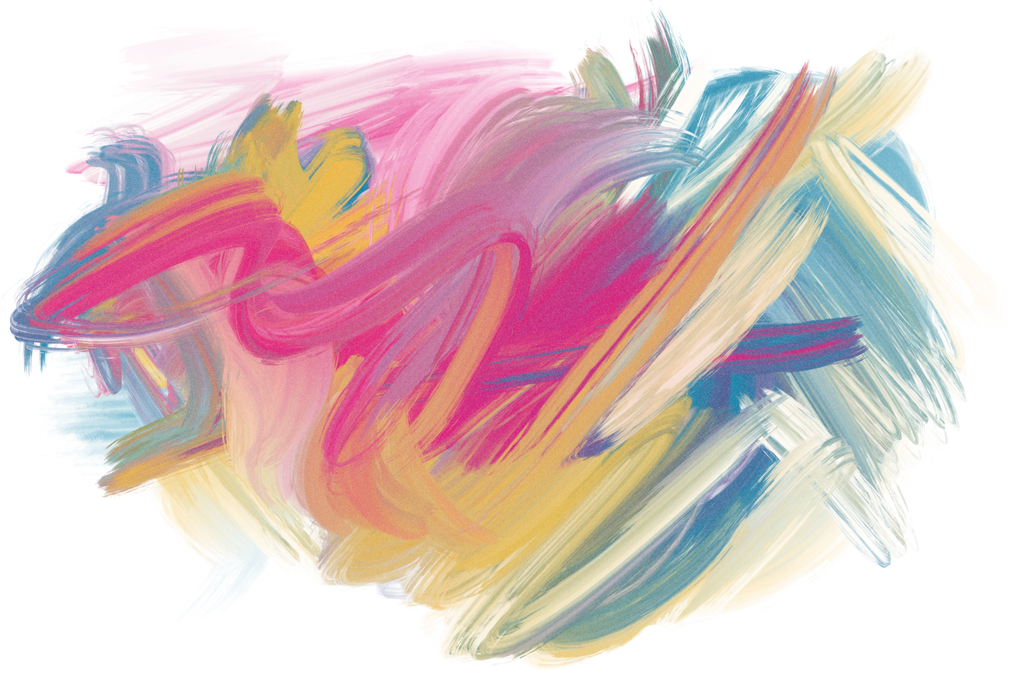





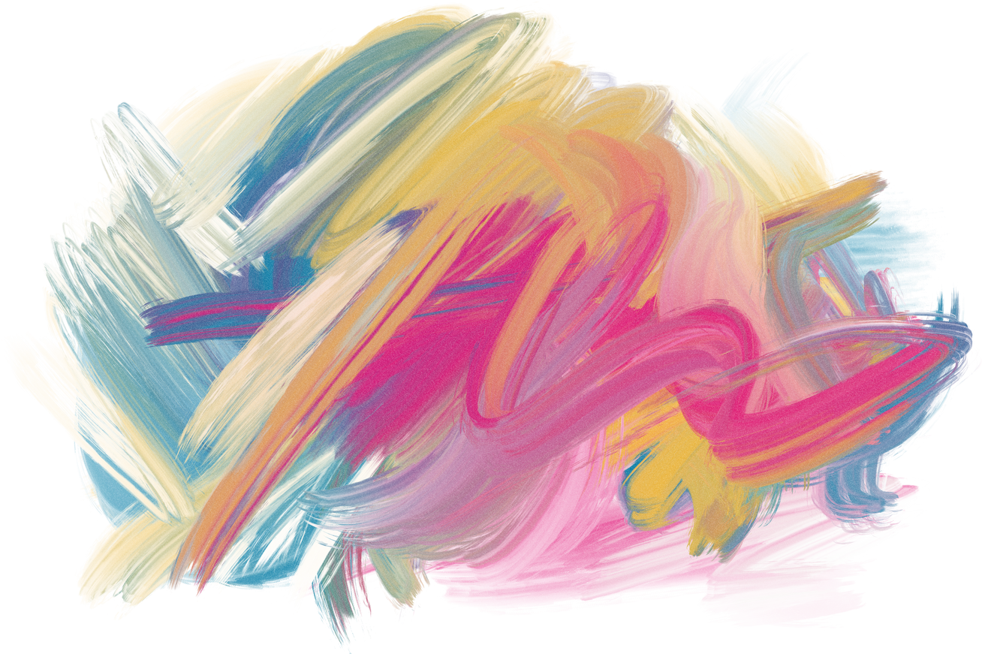
Divith
Karnati Sai Prashanth
Logesh
Madhav kishor
SVS Dhanush
CB.EN.U4AIE20013
CB.EN.U4AIE20027
CB.EN.U4AIE20032
CB.EN.U4AIE20033
CB.EN.U4AIE20068
TEAM - 11

Slide 3
OUR PRESENTATION FLOW
BFS - algebraic way
using BFS and finding Predecessors and Descendants
SCC - divide and conquer style
SCC - parallelizing the regular DFS algorithm
Graph Contraction

Slide 4
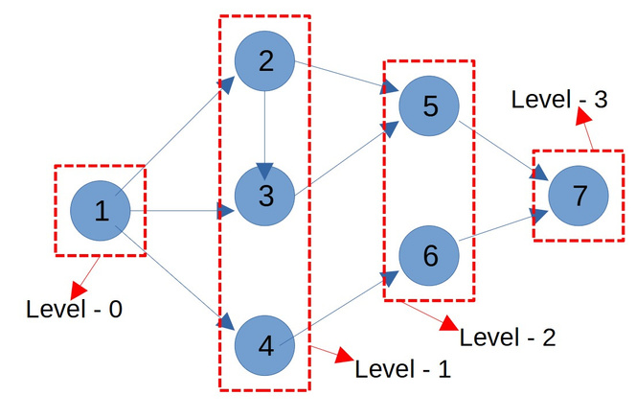

BREADTH-FIRST SEARCH
Using Matrix Algebra
level = 0
we will start from level 0
d = [ ]
take an Array D i.e distance from the Root
or the level of the particular node in the bfs tree
Frontier
f=[ ]
frontier is the last set of nodes labeled with latest level.
The node that we are goin to start with
In the next iteration we are going to explore all the neighbours of the frontier

Slide 5
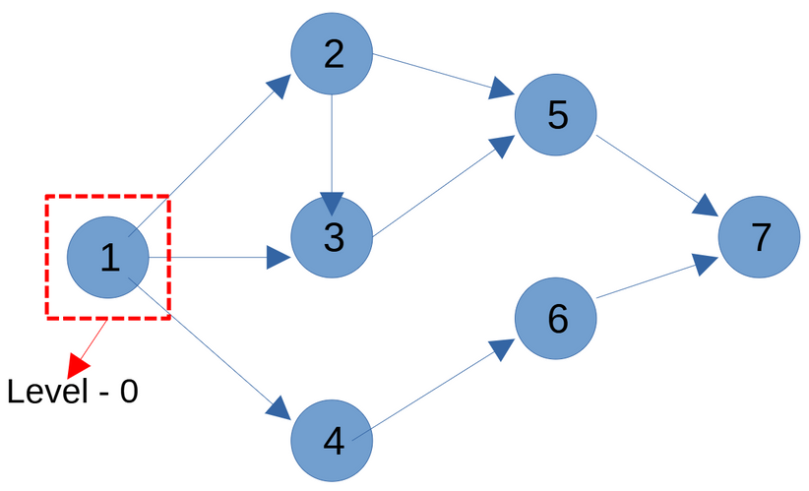

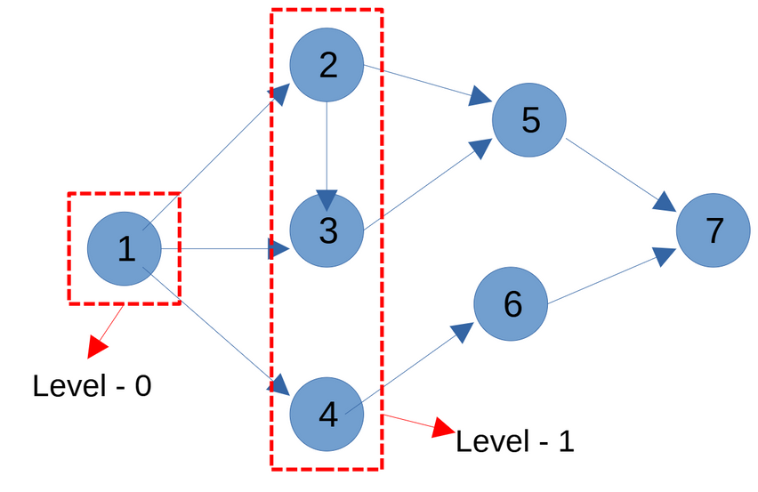
level = 0
1 2 3 4 5 6 7
d = [ 0 ]
f = [ 1 0 0 0 0 0 0]
d - tells the level,
infinity means not connected for now
f - frontier

Slide 6
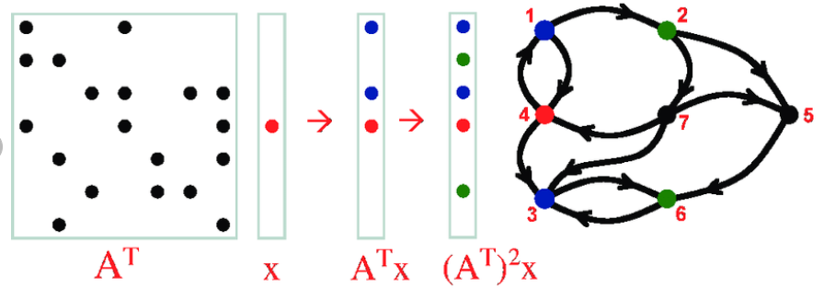
frontiers changing
f
f '
f ''

Slide 7
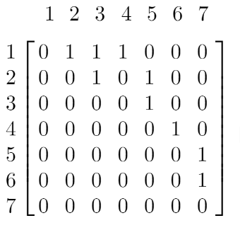
node j is in current frontier
f[j] = 1
Adjacency Matrix:
node j
new node is visited
Edge
node k
new frontier
u[k] = 1
If there is some j s.t ; f [ j ] & ajk = 1

Slide 8
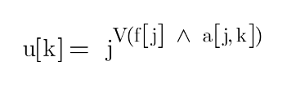
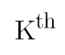

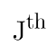

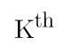


u is set to 1 if for some j ,
both are 1
The above is not the true form of multiplication
T
we do dot product => matrix-vector product

Slide 9
PSEUDO CODE:
while (f=0)
{
u = A^T * f
f' = u & (d )
update d with all elements where f' =1
set d[.] = level + 1
level = level + 1
f = f'
}
level = 0
1 2 3 4 5 6 7
d = [ 0 ]
f = [ 1 0 0 0 0 0 0]
Time Complexity is n^2 - matrix vector multiplicsstion takes the max

Slide 10

A DIVIDE-AND-CONQUER ALGORITHM
FOR Identifying
Strongly Connected Components
TEAM - 11

Slide 11
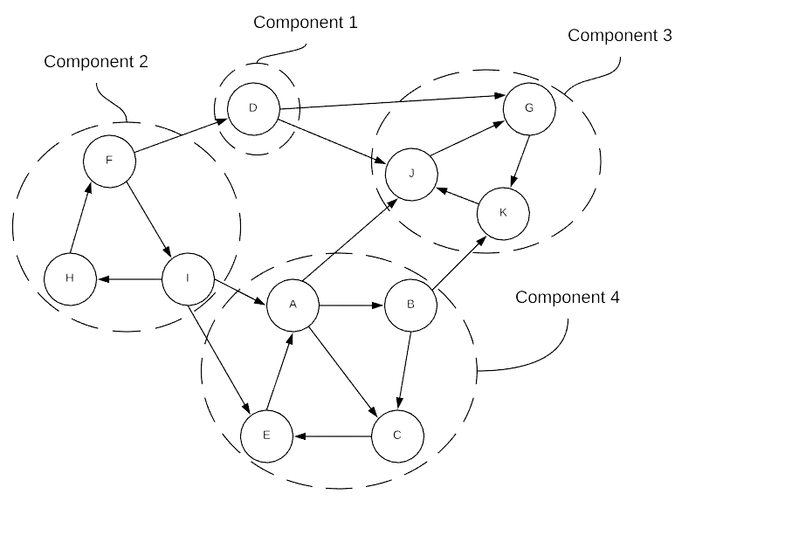
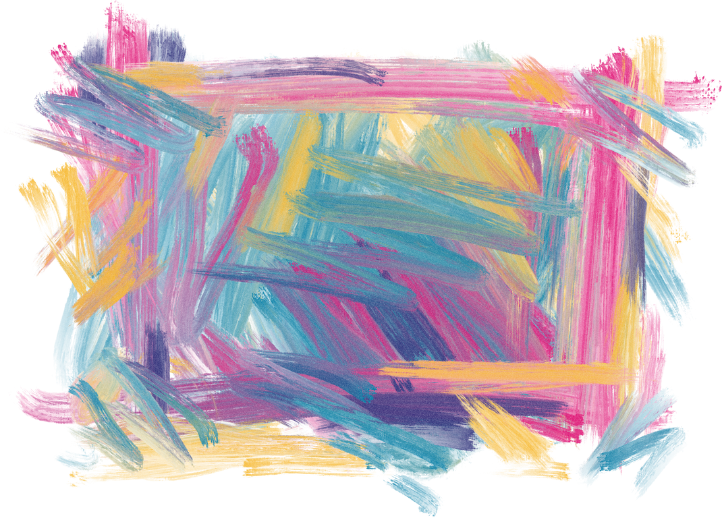
Strongly Connected Components
A strongly connected component is the portion of a directed graph with a path from each vertex to another vertex.
In the example, we can observe that every vertex is directly connected to all the vertex's in the respective component.

Slide 12

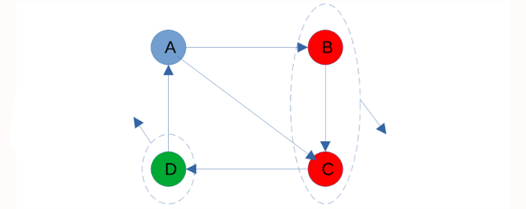
Predecessors and Descendants
Predecessors of A are nodes from which A is reachable and are found by a breadth-first search in G.
Descendants are found by a breadth-first search in G'.
Immediate predecessors
of A
Immediate Descendants of
A
B,C,D are all predecessors and descendants of A

Slide 13
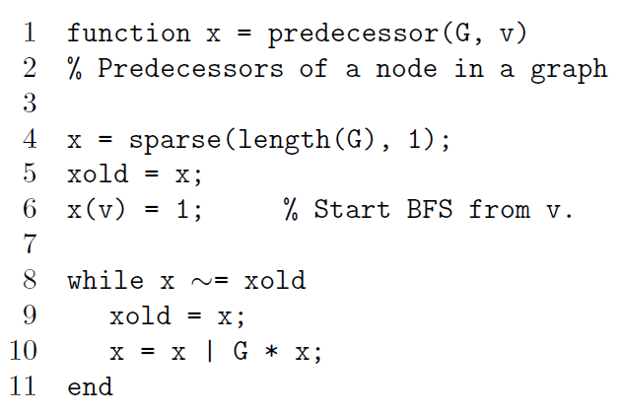
Pseudocode
IT IS BASED
ON BFS

Slide 14
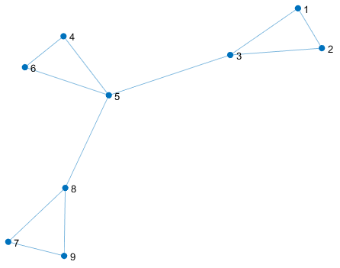
How to find the strongly connected components of the graph

Slide 15
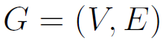
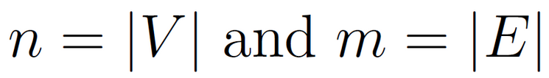
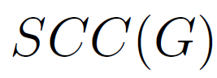
PRILIMINARIES
directed graph with vertex set V and directed-edge set E
A strongly
a connected component of G is a maximal subset S of V such that each vertex
in S is reachable from every other vertex in S.
- Strongly connected components of G
TEAM - 11

Slide 16
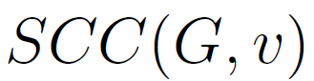
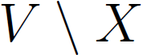
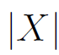
SCC(G) is a partition of V
The unique element of SCC(G) that contains v is denoted by
denotes the subset of vertices in V which are not in a subset X
The size of vertex set X is denoted by -
TEAM - 11

Slide 17
Desc(G, v), is the subset of vertices in G that are reachable from v.
Pred(G, v), is the subset of vertices from which v is reachable.
FROM THIS SUBSET OF VERTICES, WE WILL FORM A SUBGRAPH
TEAM - 11

Slide 18
The set of vertices that is neither reachable from v nor reach v is
called the remainder, denoted by
TEAM - 11

Slide 19
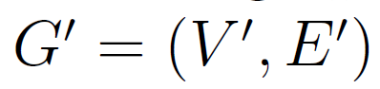
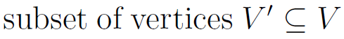
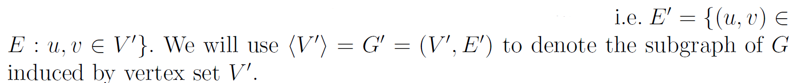
G = (V,E)
the induced subgraph
contains all edges of G connecting vertices of V'
TEAM - 11

Slide 20
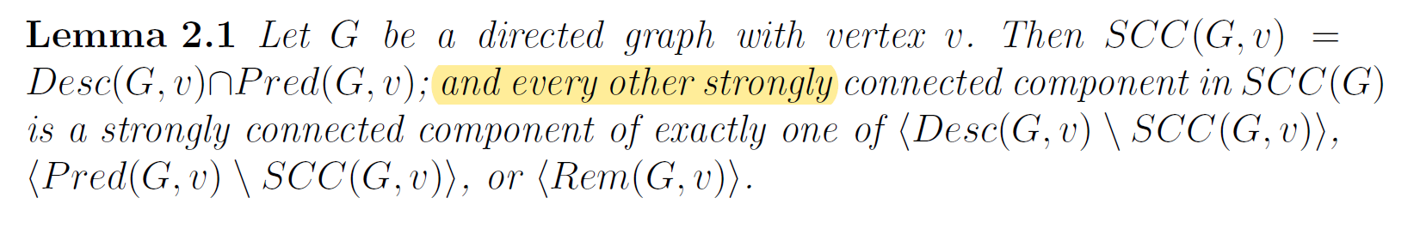
LOGIC
TEAM - 11

Slide 21
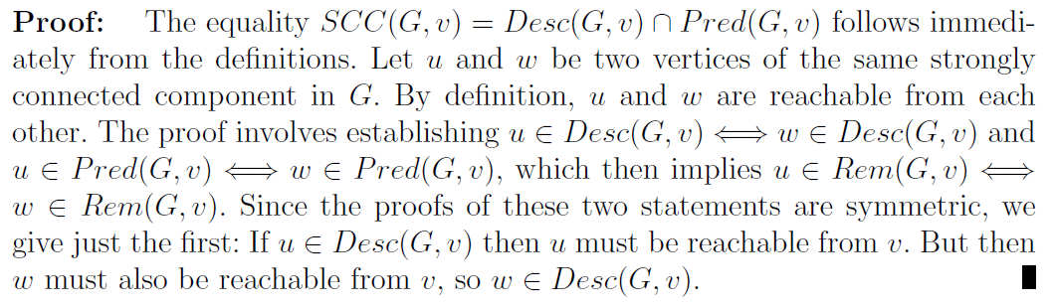
Credits : Don Coppersmith and Lisa Fleischer and
Bruce Hendrickson and Ali Pınar
https://escholarship.org/uc/item/1hx5n2df
TEAM - 11

Slide 22
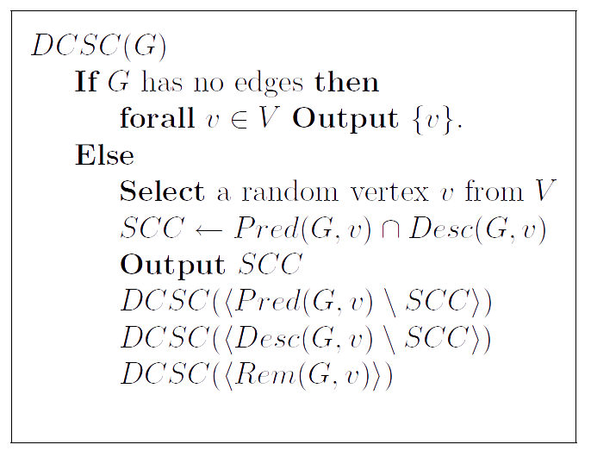
Pseudocode
TEAM - 11

Slide 23
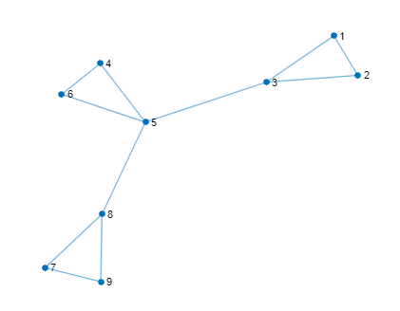
OUTPUT :

Slide 24
Parallelization perspective
this algorithm has practical parallelization on
two levels.
The recursive invocations are completely independent and so can execute independently.
The searches for predecessors and descendants allow for much more parallelism than does a depth-first search.

Slide 25
OUR PRESENTATION FLOW
BFS - algebraic way
using BFS and finding Predecessors and Descendants
SCC - divide and conquer style
SCC - parallelizing the regular DFS algorithm
Graph Contraction

Slide 26
CONNECTED COMPONENTS
DEPTH-FIRST SEARCH

Slide 27
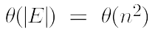
Connected Components
Undirected
Sequence Algoritm
Perform a DFS traversal on the graph. => forest
Each tree in the forest is a connected component.
runtime is for a dense graph.

Slide 28
Parallel Formulation
It is based on 3 principles:
Partition the adjacency matrix into p parts.
Each processor computes the DFS forest on the graph visible to it.
Merge the forests to get the complete final forest. => connected componenets

Slide 29
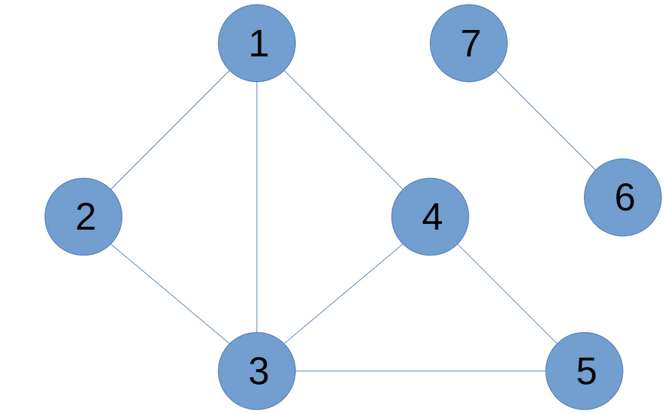
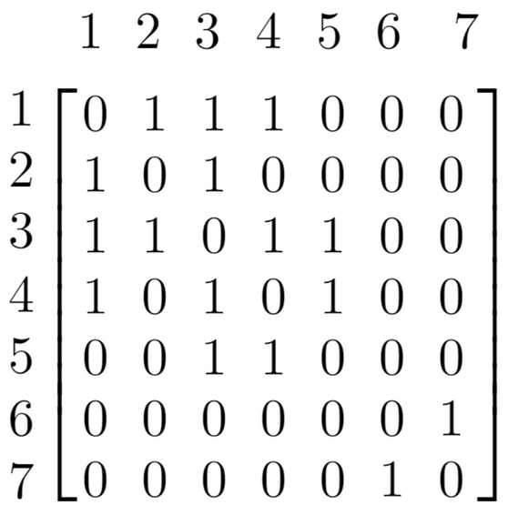
1st Formulation
Row wise partitioning of the adjacency matrix.
Adjacency Matrix:

Slide 30
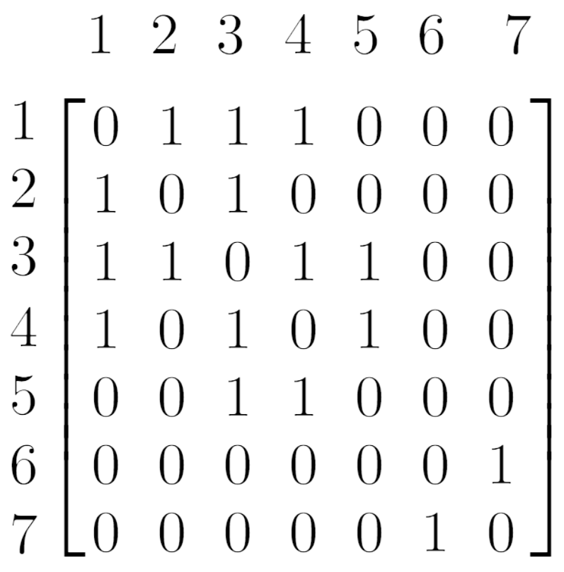
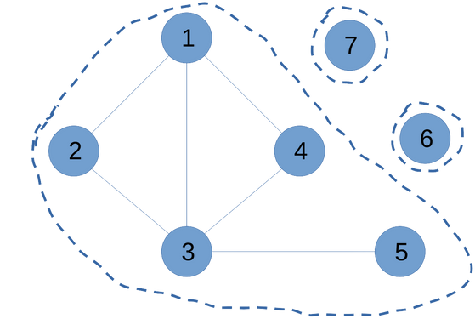
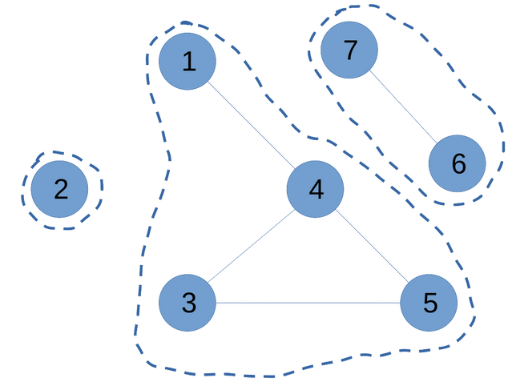
P1
P2
TEAM - 11

Slide 31
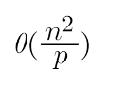
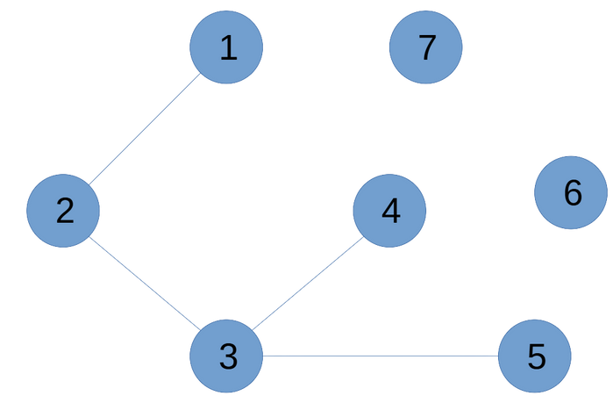
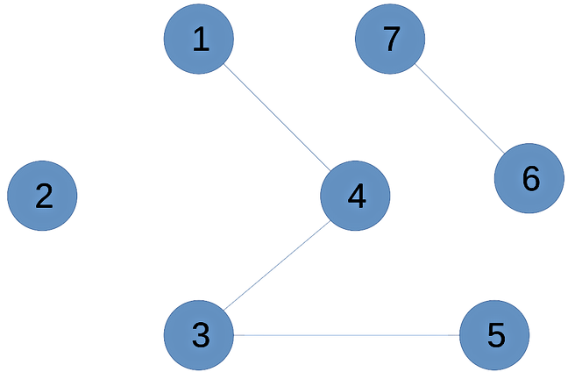
2nd Formulation
DFS on each processor:
=> number of edges or entries of the adjacency matrix visible on each processor
P1
P2

Slide 32
3rd Formulation
Merge the forests: Union find data structure.
find(u) - Identify the set it belongs to.
Merge(u,v) - Union/Merge the sets if u and v belongs to different sets.

Slide 33
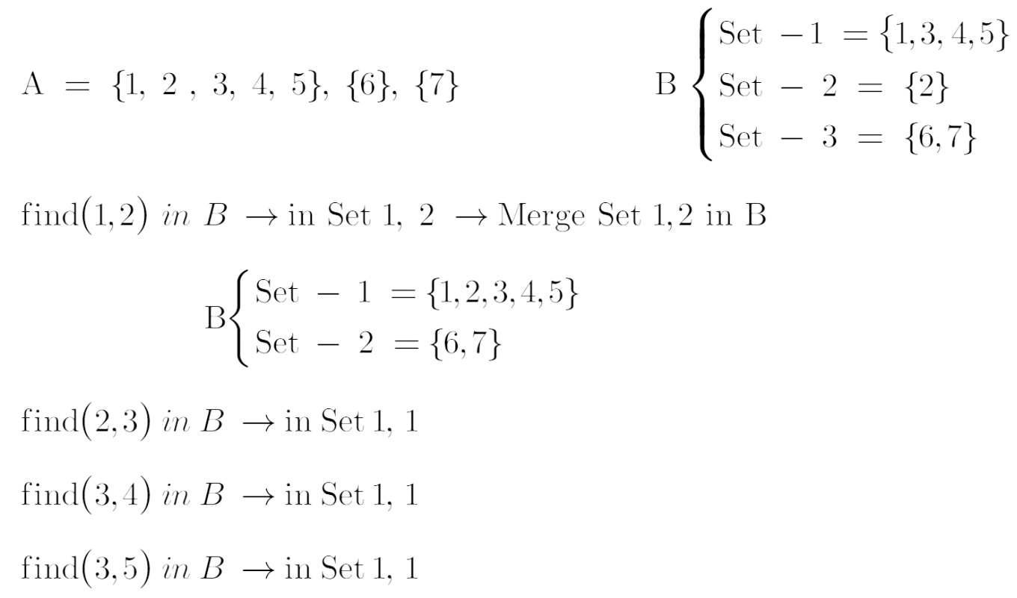

Slide 34
Merge A into B (update B)
Given two forests A & B:
For each edge (u,v) in A:
x = find(u) in B
y = find(v) in B
if x != y:
Merge(x,y) in B
We need to get log(p) iterations to get the final set/forest.

Slide 35
Graph Contraction
Contraction is a common operation in recursive compu?tations on graphs, appearing, for example, in some graph partitioning algorithms
and in numerical multigrid solvers.
TEAM - 11

Slide 36
Graph contraction can be implemented in parallel by
sparse matrix multiplication.
The input is a graph and an integer label for each node
merges nodes with the same label
TEAM - 11

Slide 37
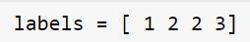
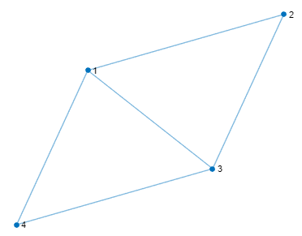
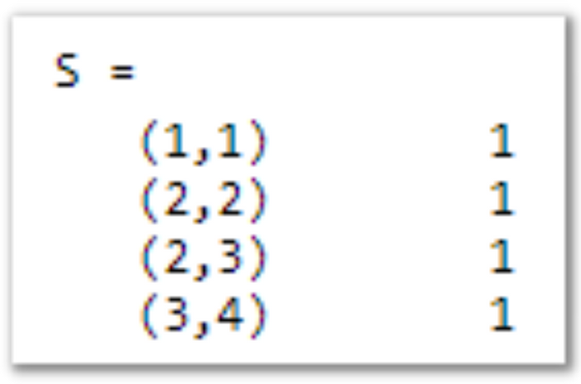
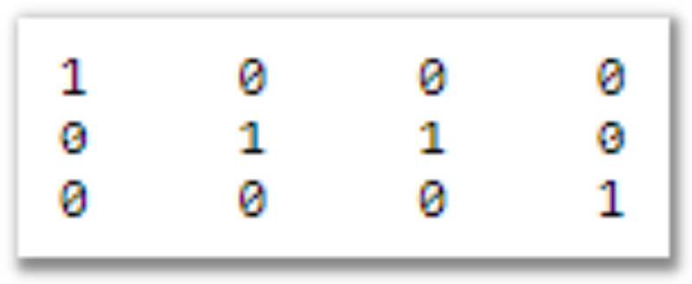
We from the sparse matrix S, which has a column for every node of the input graph
and a row for every node of the quotient graph.
TEAM - 11

Slide 38
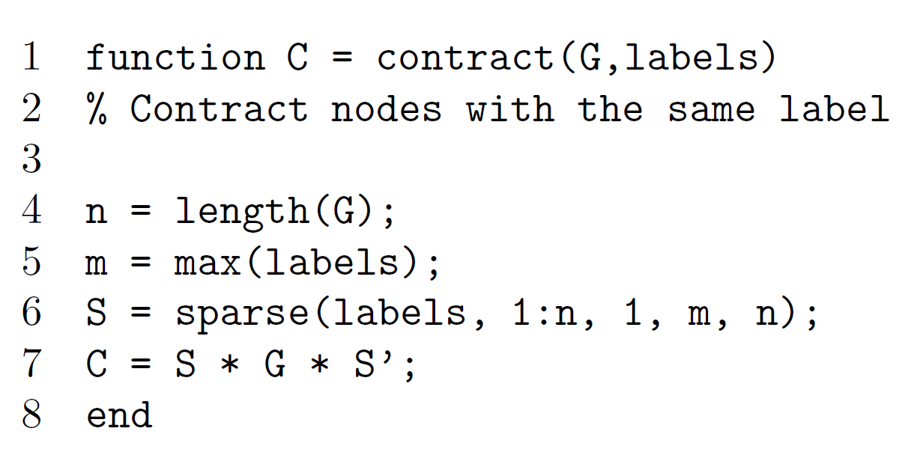
Complexity is 2*n^3
TEAM - 11

Slide 39

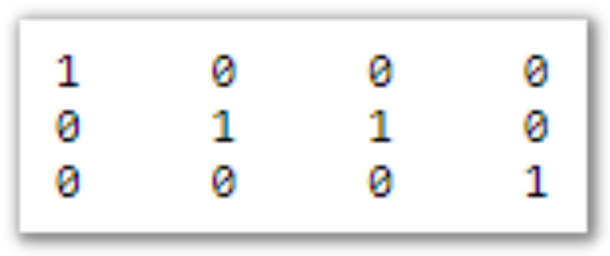
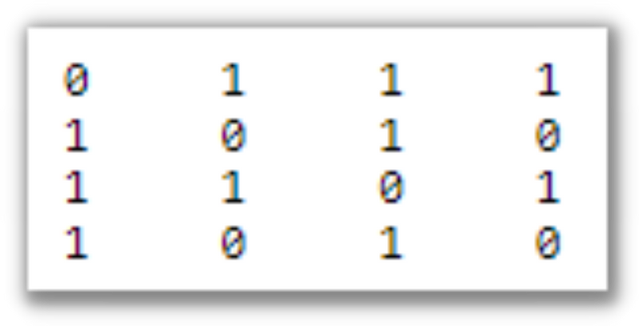
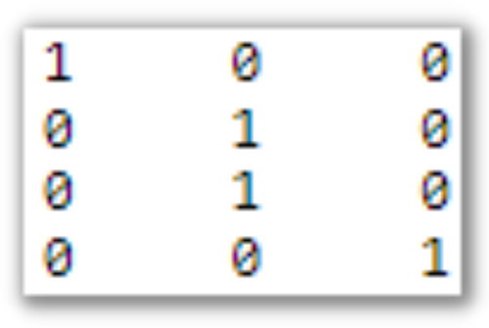
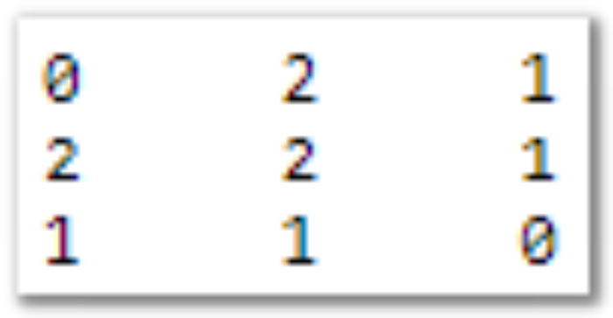

3 X 4
4 X 4
4 X 3
TEAM - 11

Slide 40
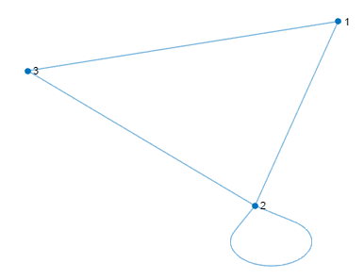
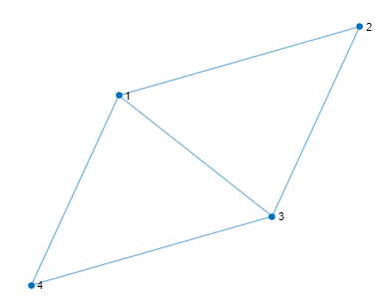
OUTPUT from our MATLAB implementation
TEAM - 11

Slide 41
Thank
you!
TEAM - 11

